Slide 1


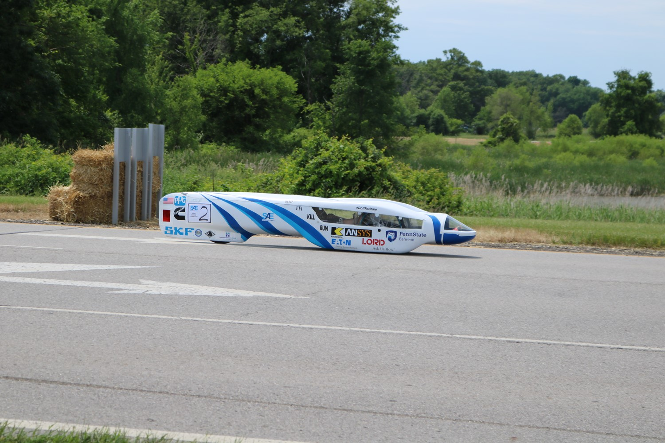
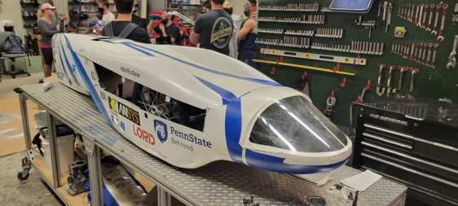
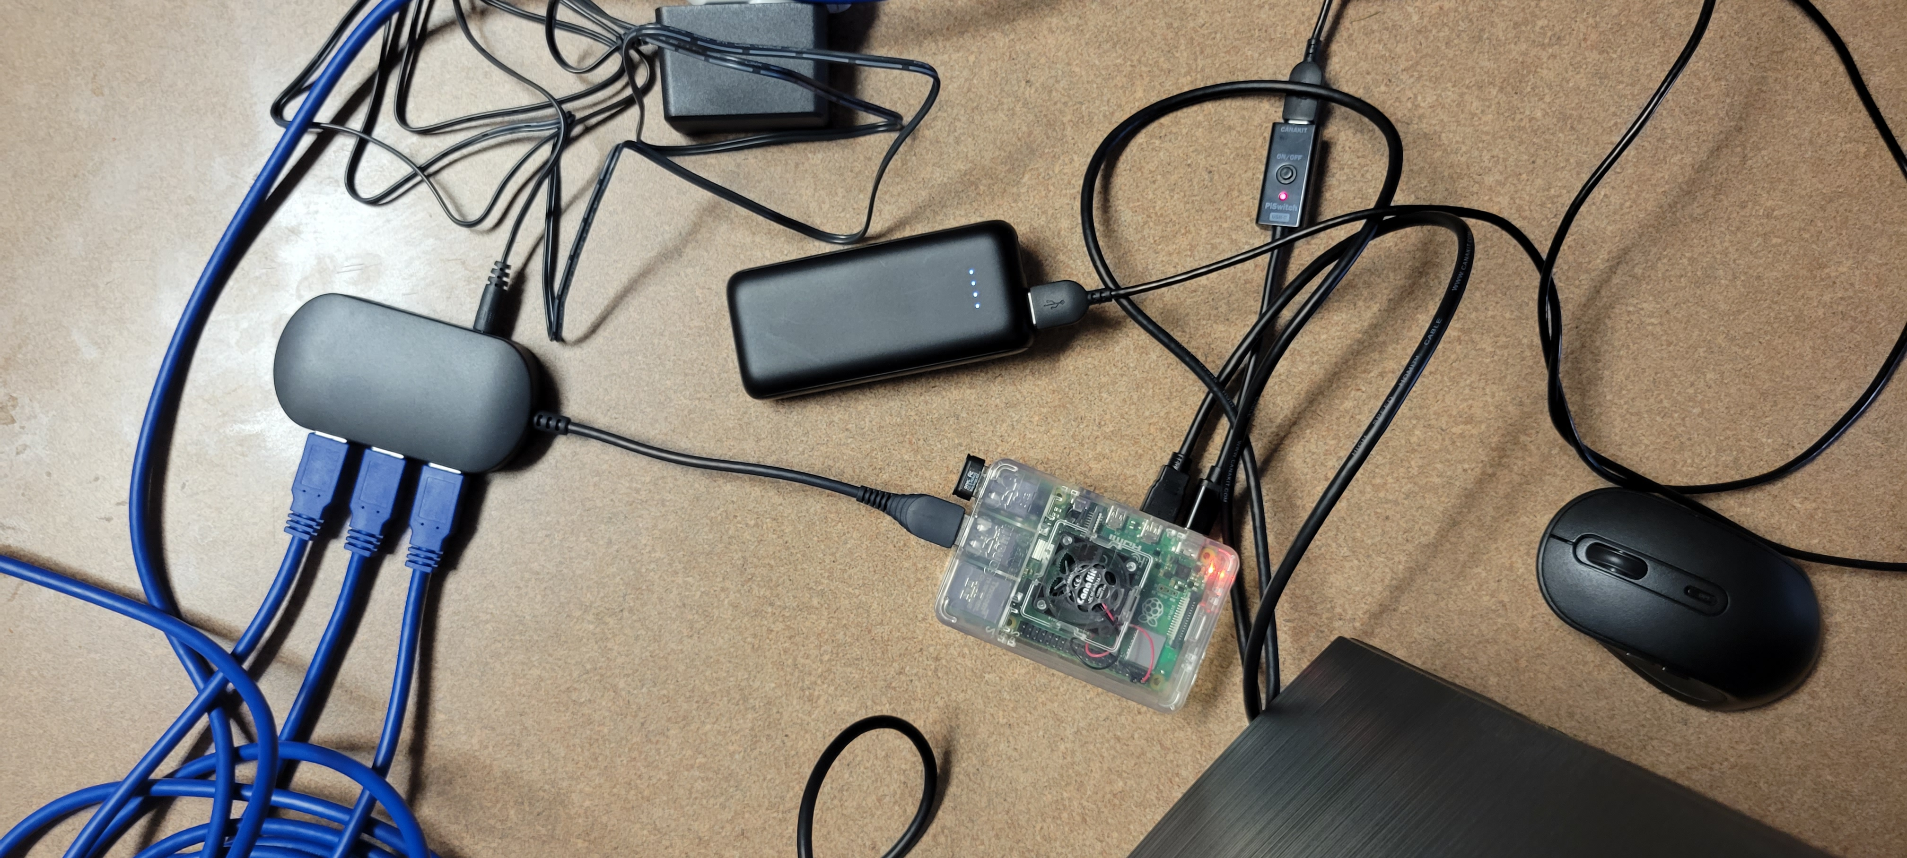
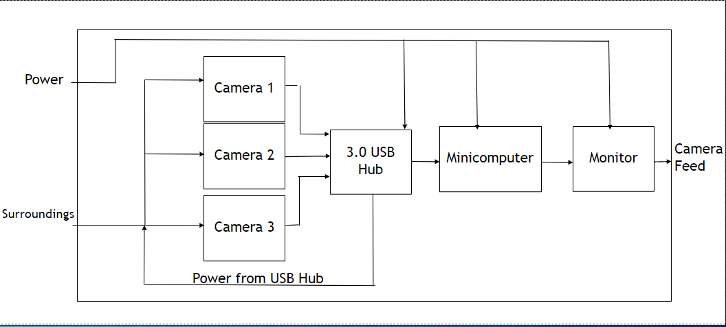
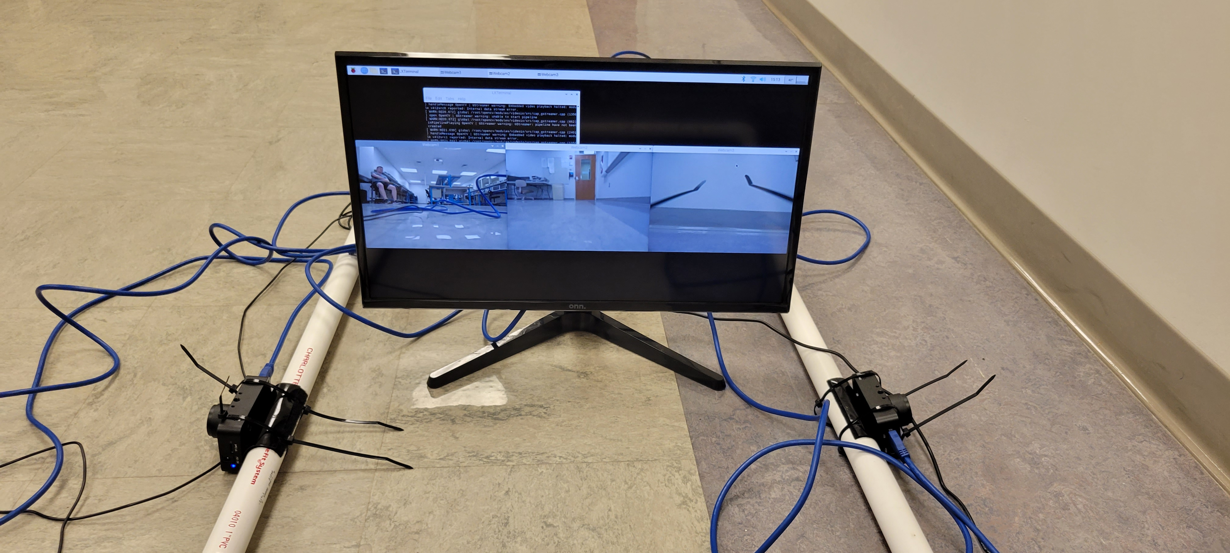
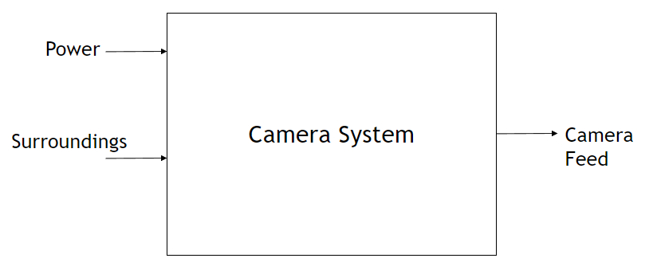
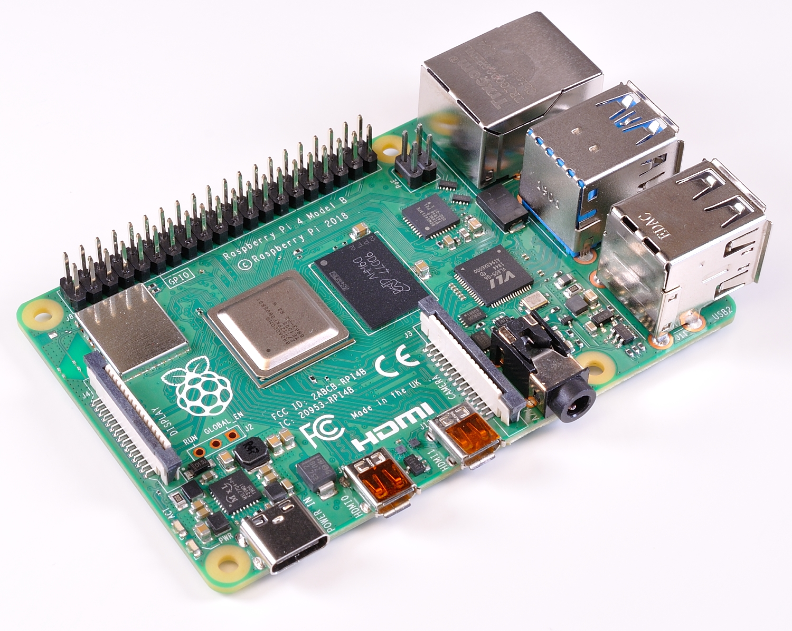
Super Mileage Vehicle Camera System
2022 Richard J. Fasenmyer Engineering Design Conference
Andrew Breier
Blake Pahler
Anthony Mazzocco
Faculty Advisor: Dr. Myung Cho
Project Sponsor: Jill Johnson
Background:
The Society of Automotive Engineer's club (SAE) is responsible for building the SMV, which can travel 2,000-3,000 miles on a single gallon of gas. The multidisciplinary SAE club has multiple small groups of engineering students (Mechanical, Electrical, Computer, etc.) working on each component of the vehicle separately. The society attends an annual competition in which universities and colleges all over the world can compete for the best fuel economy vehicle. Each year the club looks to construct and improve upon the existing vehicle to maximize fuel efficiency.
Needs Statement:
The system needs to give the driver a minimum of 160 degrees field of view from the front of the vehicle. Additionally, the system must allow the driver to see 1.5 meters above the ground and 6 meters out in front of the vehicle. The system will be low-cost, lightweight, battery powered, and have a minimum count of 720-1080 pixels resolution.
Objective Statement:
The goal of this project is to design a low-profile camera system for the SMV to increase driver visibility and safety. To accomplish this, a low-profile camera system will be connected to a microcomputer with a simple Operating System (OS). The system will display the live feed of the driver's surroundings to a monitor inside the vehicle. Depending on cost and time, the system may also implement an audio transceiver to communicate with the driver.
Level 0 Design:
As shown in the level 0 diagram, our design has 2 inputs and 1 output. The inputs consist of power and surroundings. The power is supplied from a portable battery measured at 26,000 mAh. This was chosen because it needs to power a USB 3.0 hub and the Raspberry Pi 4B. The output of the system is what the driver sees on the monitor.
Project Steps:
Our group first had to decide how we would be able to show three different cameras show up onto one monitor. We had decided that the best way to go about this was to use a minicomputer. As these are readily available and inexpensive. Out of all our options, we chose to use the Raspberry Pi 4B, as this minicomputer has the ports needed to satisfy the project. As this can be battery powered and in turn power all of the other components. We then chose to use USB 3.0 cameras, as this would be the best way to make three windows show up at once and run at the same speed. After further testing, it was found that the Raspberry Pi 4B was unable to power each of the cameras by itself. Due to this, our group then decided to use a USB 3.0 hub with external power (also powered by a battery), giving us the necessary power for each of the cameras. With all of this, we were able to obtain a final design for the system.
Figure 6: Raspberry Pi 4B system, USB hub with cameras, and portable battery connections
Coding:
The coding language we used in this project was python, using the Thonny interface. In python, we used the OpenCV and time libraries. This was chosen because OpenCV can send a live feed form each of the USB cameras and show them on the screen in real time. Also, the resolution can be easily adjusted, and each window can be moved as well. The time library is used to start a sleep function at the beginning of the code to allow the driver to plug in cameras in the order they wish. Also, we edited certain files in the Raspberry Pi system to have the program run as the computer started up.
Conclusion:
Overall, the Super Mileage Vehicle project focuses on increasing the visibility of the driver by implementing a simple camera system. The system's simple user interface allows the driver to easily view and identify objects at a minimum of 1.5 meters from the ground and 6 meters in front of the vehicle. This will allow the SAE team to eventually replace the current method of using window cutouts, which will improve the aerodynamics, visibility, and field of view. This project will also allow future mechanical engineers to create a gyroscopic mount to reduce video sway.
Figure 7: Final Output To Monitor
Abstract:
The Super Mileage Vehicle (SMV) camera system project focuses on improving the driver's ability to clearly see out of the vehicle. The previous method used by the driver was looking out of small cutouts on either side of vehicle and between their feet to see the front windshield. The new system will be implemented by using three simple cameras connected to a Raspberry Pi 4, and the video will be displayed to a monitor inside of the vehicle. The purpose of this design project is to improve the safety of the driver by increasing the field of view (FOV) so that they can clearly see more of their surroundings.
Problem Statement: Design a low-profile camera system for the super mileage vehicle.
Figure 1: 2018 SMV in use
Figure 2: Current SMV design
Final Design:
The level 1 diagram shows how the battery will be connected to the Raspberry Pi 4B and the USB 3.0 Hub. The USB hub, which is connected to the RPi , will then supply power to the 3 cameras. These cameras will take in the surroundings and push it to the RPi 4. This will then output the images to the monitor which will then be viewed by the driver of the vehicle. The monitor will be powered via USB from the RPi 4 as well.
Figure 5: Level 1 Design
References:
[1] Raspberry Pi, “Raspberry pi 4 model B,” Raspberry Pi. [Online]. Available: https://www.raspberrypi.com/products/raspberry-pi-4-model-b/. [Accessed: 20-Dec-20221].
[2] A. Rosebrock, “Multiple cameras with the Raspberry Pi and opencv,” PyImageSearch, 17-Apr-2021. [Online]. Available: https://pyimagesearch.com/2016/01/18/multiple-cameras-with-the-raspberry-pi-and-opencv/. [Accessed: 21-Dec-2021].
[3]“Five ways to run a program on Your Raspberry Pi at startup,” Dexter Industries. [Online]. Available: https://www.dexterindustries.com/howto/run-a-program-on-your-raspberry-pi-at-startup/. [Accessed: 15-Apr-2022].
Figure 3: Level 0 Design
Figure 4: Raspberry Pi 4B
2022 Richard J. Fasenmyer Engineering Design Conference

